Slide 1
droidvision
Soldier Design Competition
Ian Miller & Rishi Shah
MIT Army ROTC

Slide 2
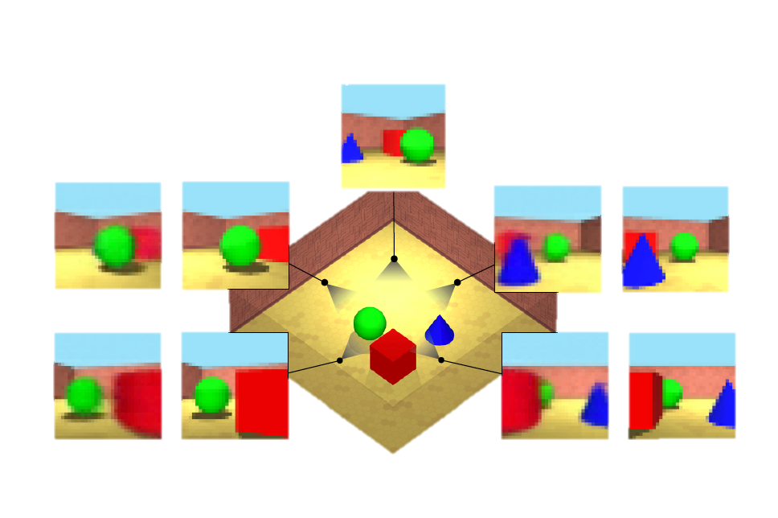
Object Detection & Localization at the Edge
Images adapted from Eslami et al., 2018 and Udacity, Inc

Slide 3
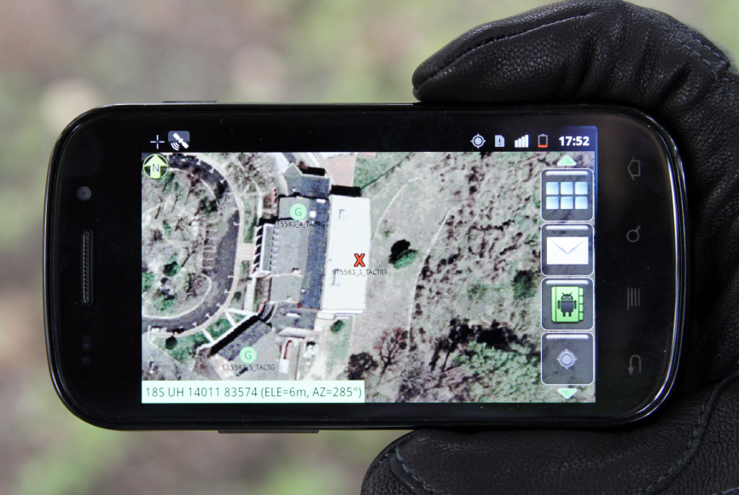
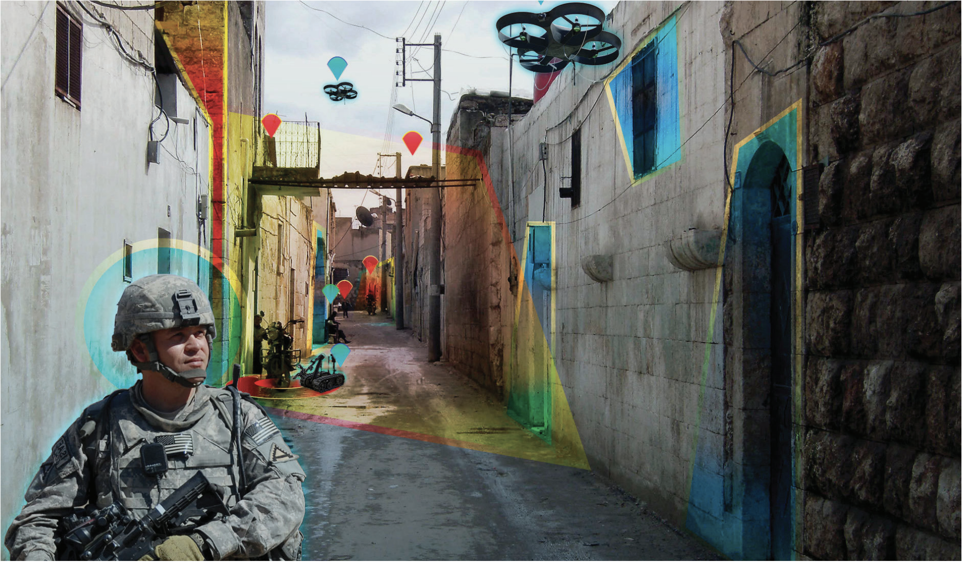
Automatic REPORTING TO net warrior system
DROIDVISION
Images adapted from C4ISRNET Special Report, Dec 2018 and US Army Publications

